Slide 1
Multi Wheel SkatePark Proposal – Plottingham Field
Public Consultation - Spring 2022

Slide 2
Multi Wheel Skatepark PROPOSAL
The popular skatepark at Plottingham Field is in need of an upgrade
Bridport Town Council has been working with skatepark designers Maverick and young people to develop an exciting new proposal for a multi wheel skatepark
This public consultation seeks your views on the proposed multi wheel skatepark ahead of an application for planning permission

Slide 5
Multi Wheel Skatepark PROPOSAL
Consultations with local skaters, BMX and scooter users have informed the multi wheel skatepark design developed by Maverick
The ambition is to provide young people with a contemporary facility that will support active and healthy outdoor activity for all abilities in the Bridport Area

Slide 9
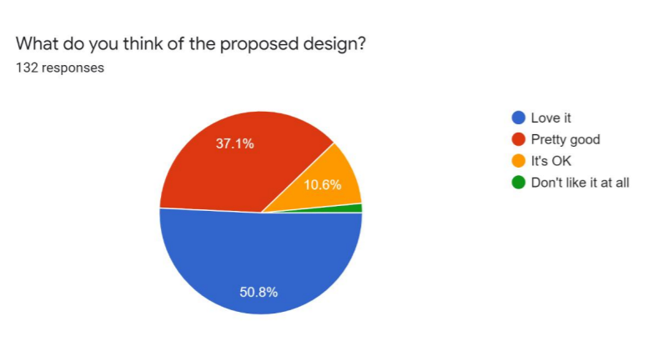
Survey findings to date

Slide 10
Multi Wheel Skatepark PROPOSAL
We want to hear your views about the multi wheel skatepark proposal
Go to the online questionnaire at:
https://www.smartsurvey.co.uk/s/QHHLN0/
And submit your comments by
May 13 2022
Or email: david.dixon@bridport-tc.gov.uk

