Slide 1
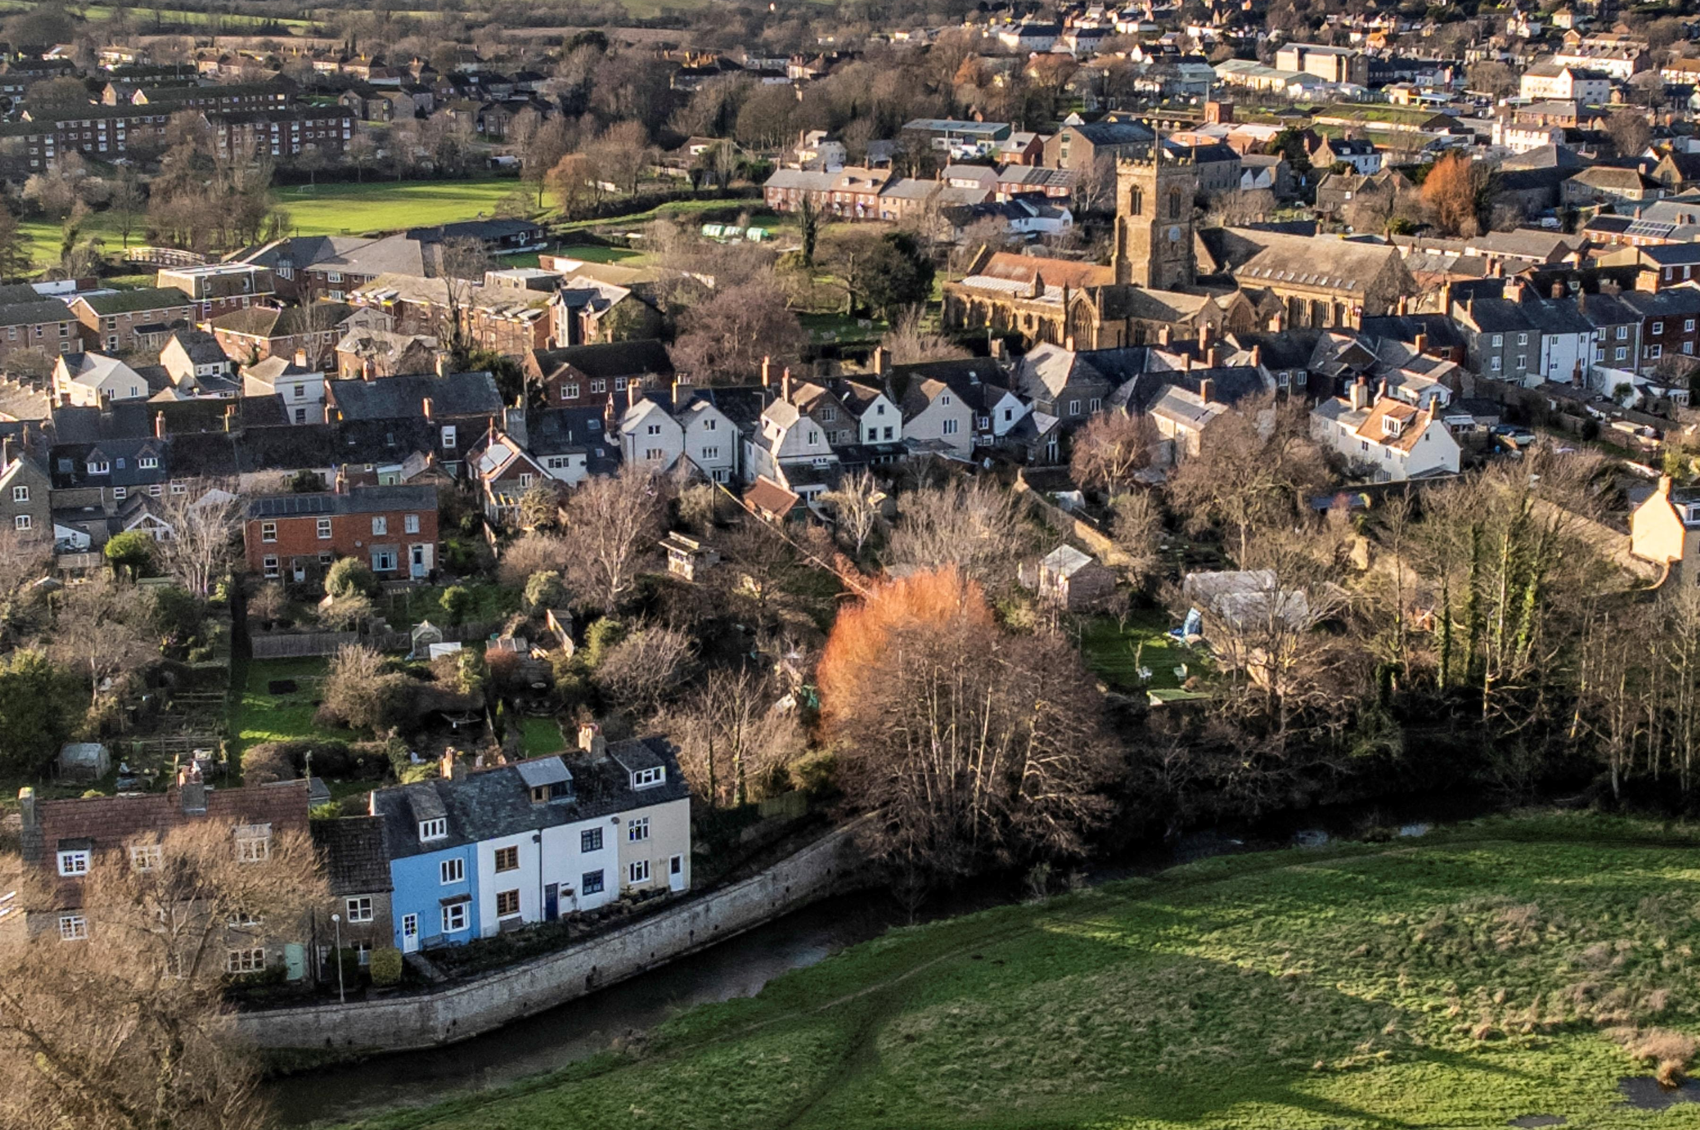
Bridport Area Neighbourhood Plan 2020-2036
Review 2025 O
Bridport Town & Symondsbury Parish Councils October 2025

Slide 2
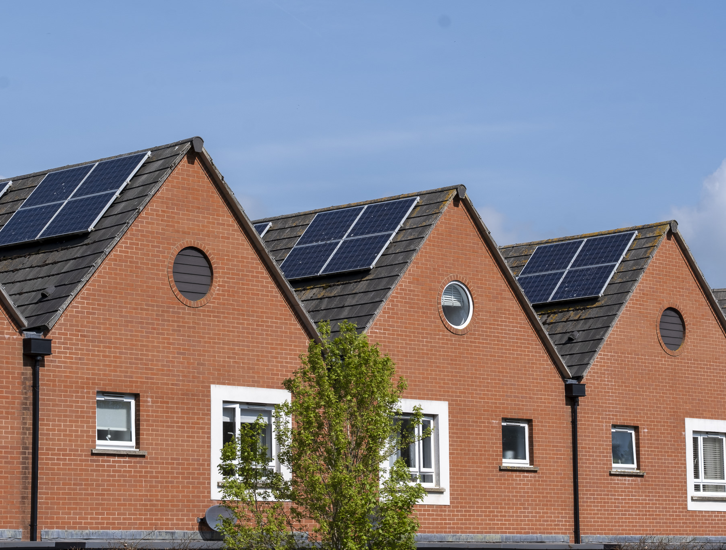
Neighbourhood Plans are valuable resources
BANP has been influential within the planning process since 2020
The Bridport Area Neighbourhood Plan 2020-2036 (BANP) has been a valuable resource for the local community and has been drawn on extensively in planning related matters.
See Annual Monitoring Reviews: https://www.bridport-tc.gov.uk/projects/neighbourhood-plan/

Slide 3
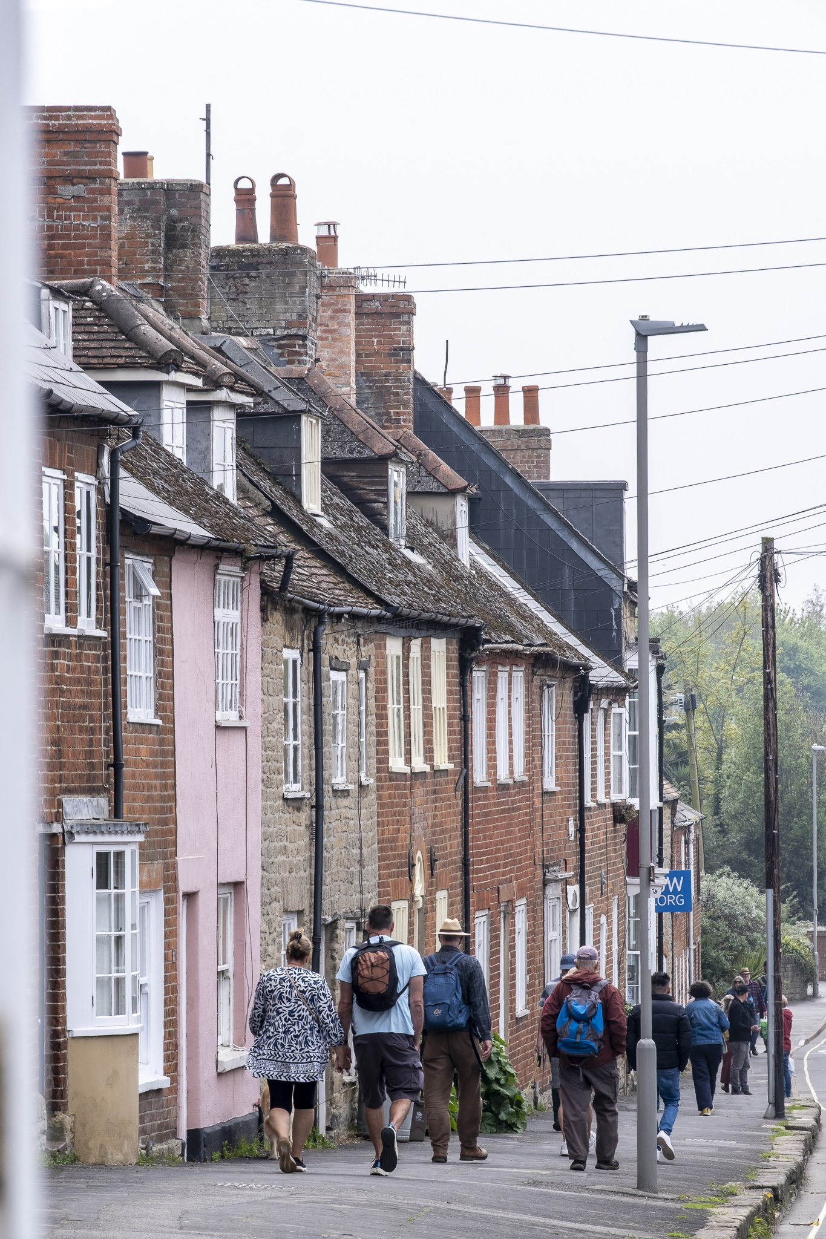
BANP is over five years old
A first ‘light’ review was approved by the Joint Councils Committee (JCC)
It is good practice to review neighbourhood plans every five years. Plans older than five years risk carrying less weight in the development process. The JCC, responsible for the BANP, agreed to undertake a ‘light’ review in 2025.

Slide 4

A ‘light’ review
The Review was undertaken by members of the Community Steering Group
Work on the review sought to identify:
Updates resulting from changes to local/ national policies, in particular the Dorset Local Government Review (2023);
Updates resulting from new evidence generated by commissioned reviews;
Amendments that reflect improvements to the clarity of phrasing.

Slide 5
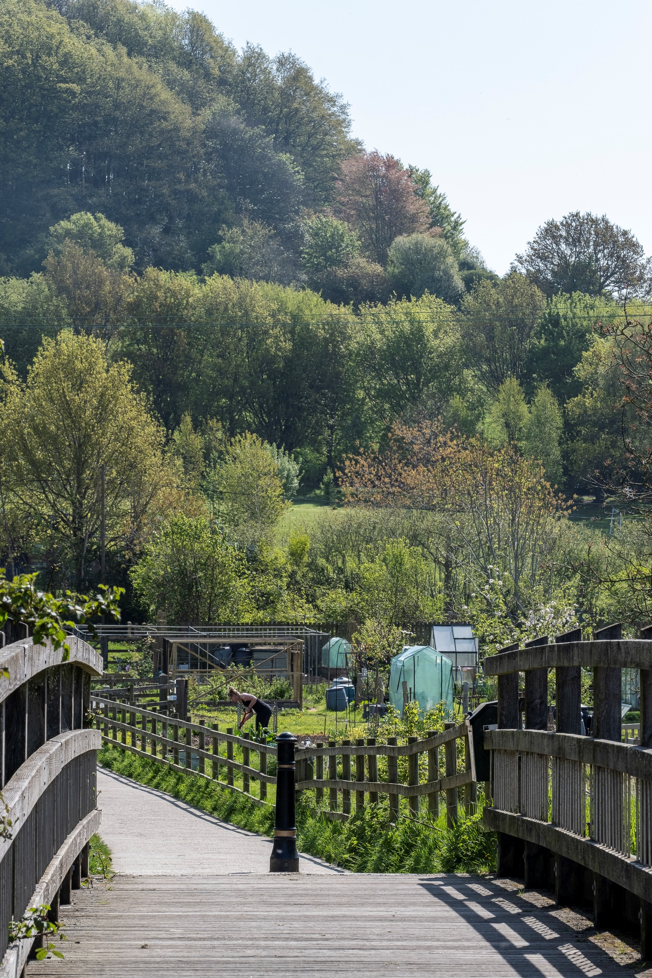
The review was funded by grants from Locality
New and updated information was gathered
The review was supported with a grant from Locality. Three studies were commissioned to inform the review:
A Workspace and Business Needs Assessment;
A revised Bridport Area Housing Needs Assessment (HNA);
A Site Options Assessment.
The JCC also approved a HNA Supplement produced by the BANP Steering Group to offer a local interpretation of the revised HNA.

Slide 6
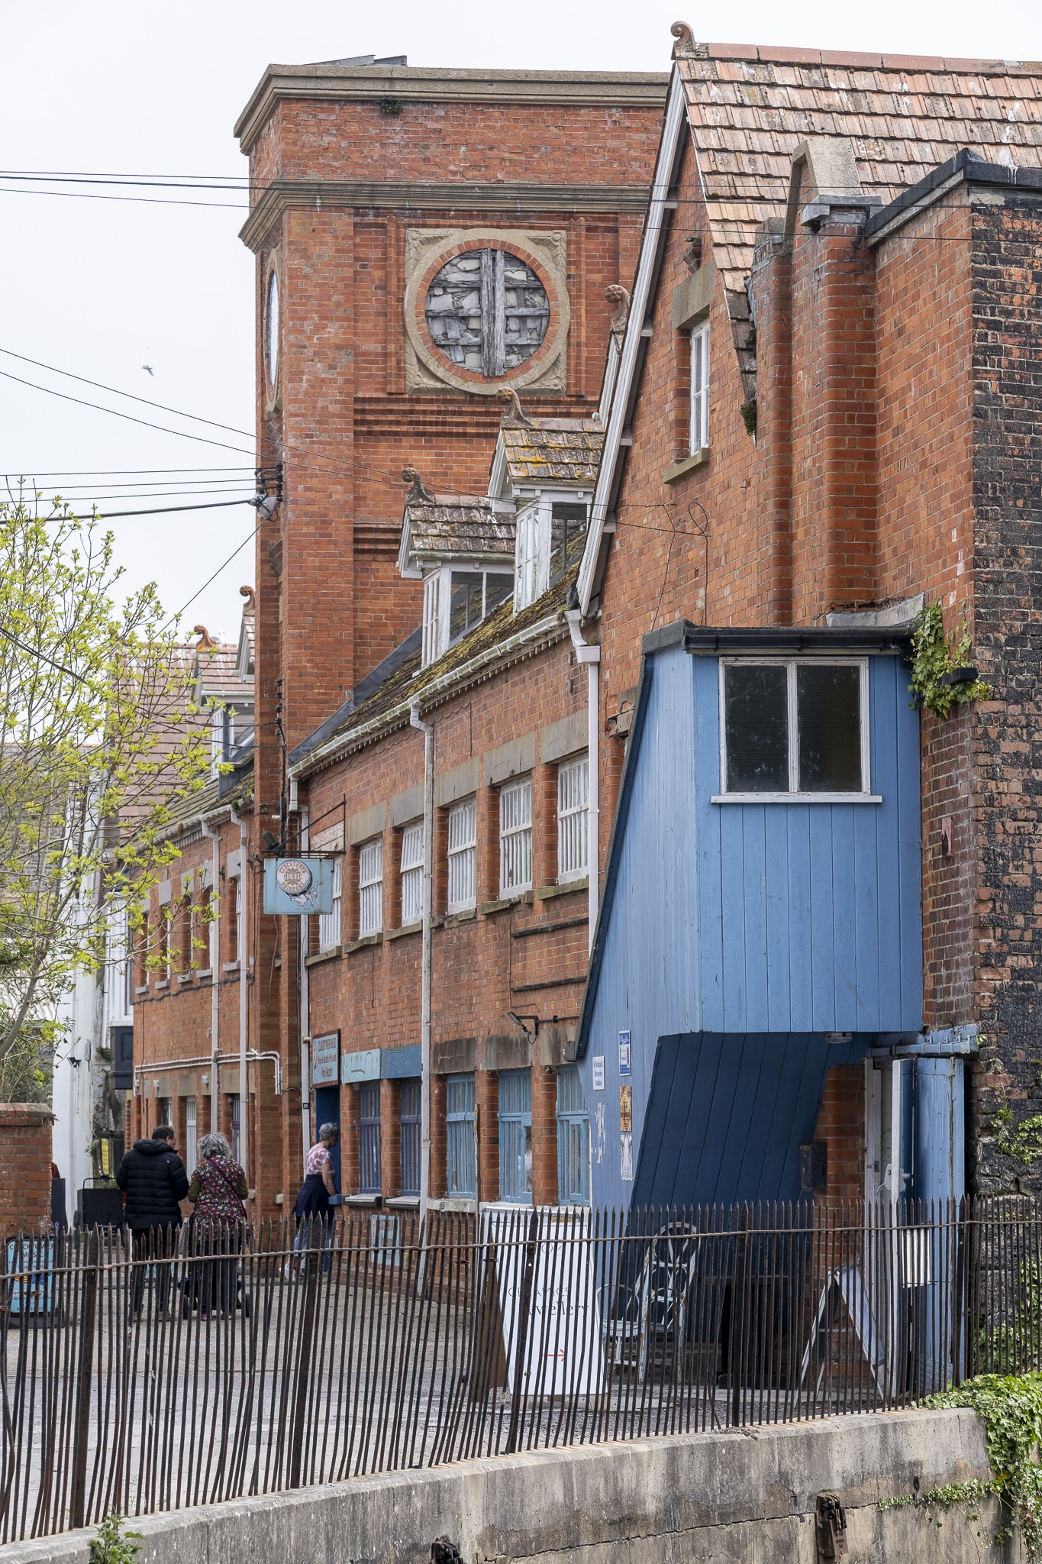
Material modifications are proposed:
As a result of the 2025 review, the main changes proposed for the BANP are:
Factual updates resulting from commissioned reviews and changes in local/ national policies, in particular the Dorset Local Government Review (2023).
Amendments to policies that reflect improvements to the clarity of phrasing as well as changes to the local and national policy frame.

Slide 7
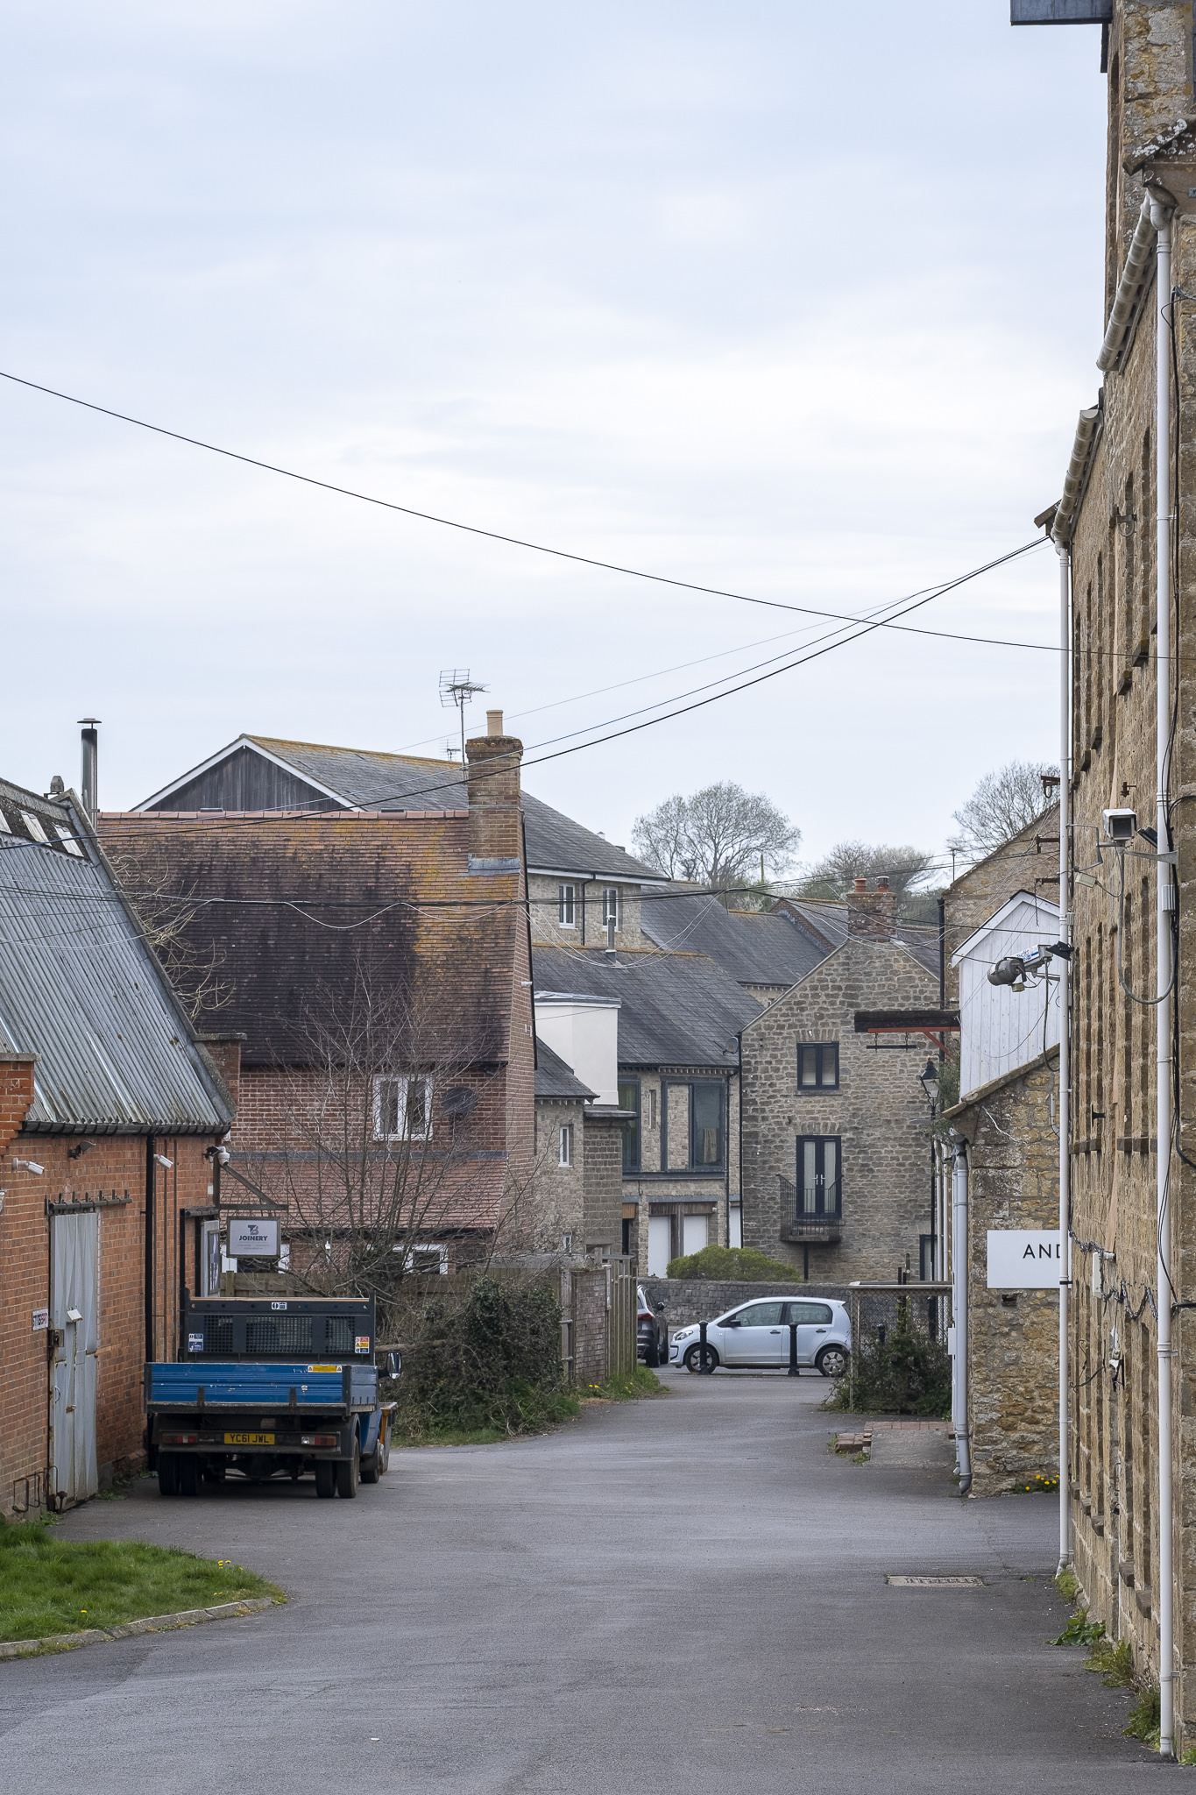
Review Considerations
The changes respond to the Bridport Area Housing Needs Assessment (2025) and uses new information to update, clarify and support the existing policies around affordable housing.
AECOMs Site Options Assessment 2025 has been added to the BANP Evidence Base and used to update the supporting text for housing policies.
In terms of housing, changes are relatively limited and should not impact on viability.
A Workspace and Business Needs Assessment has been undertaken and used to support the economy and employment policies.

Slide 8
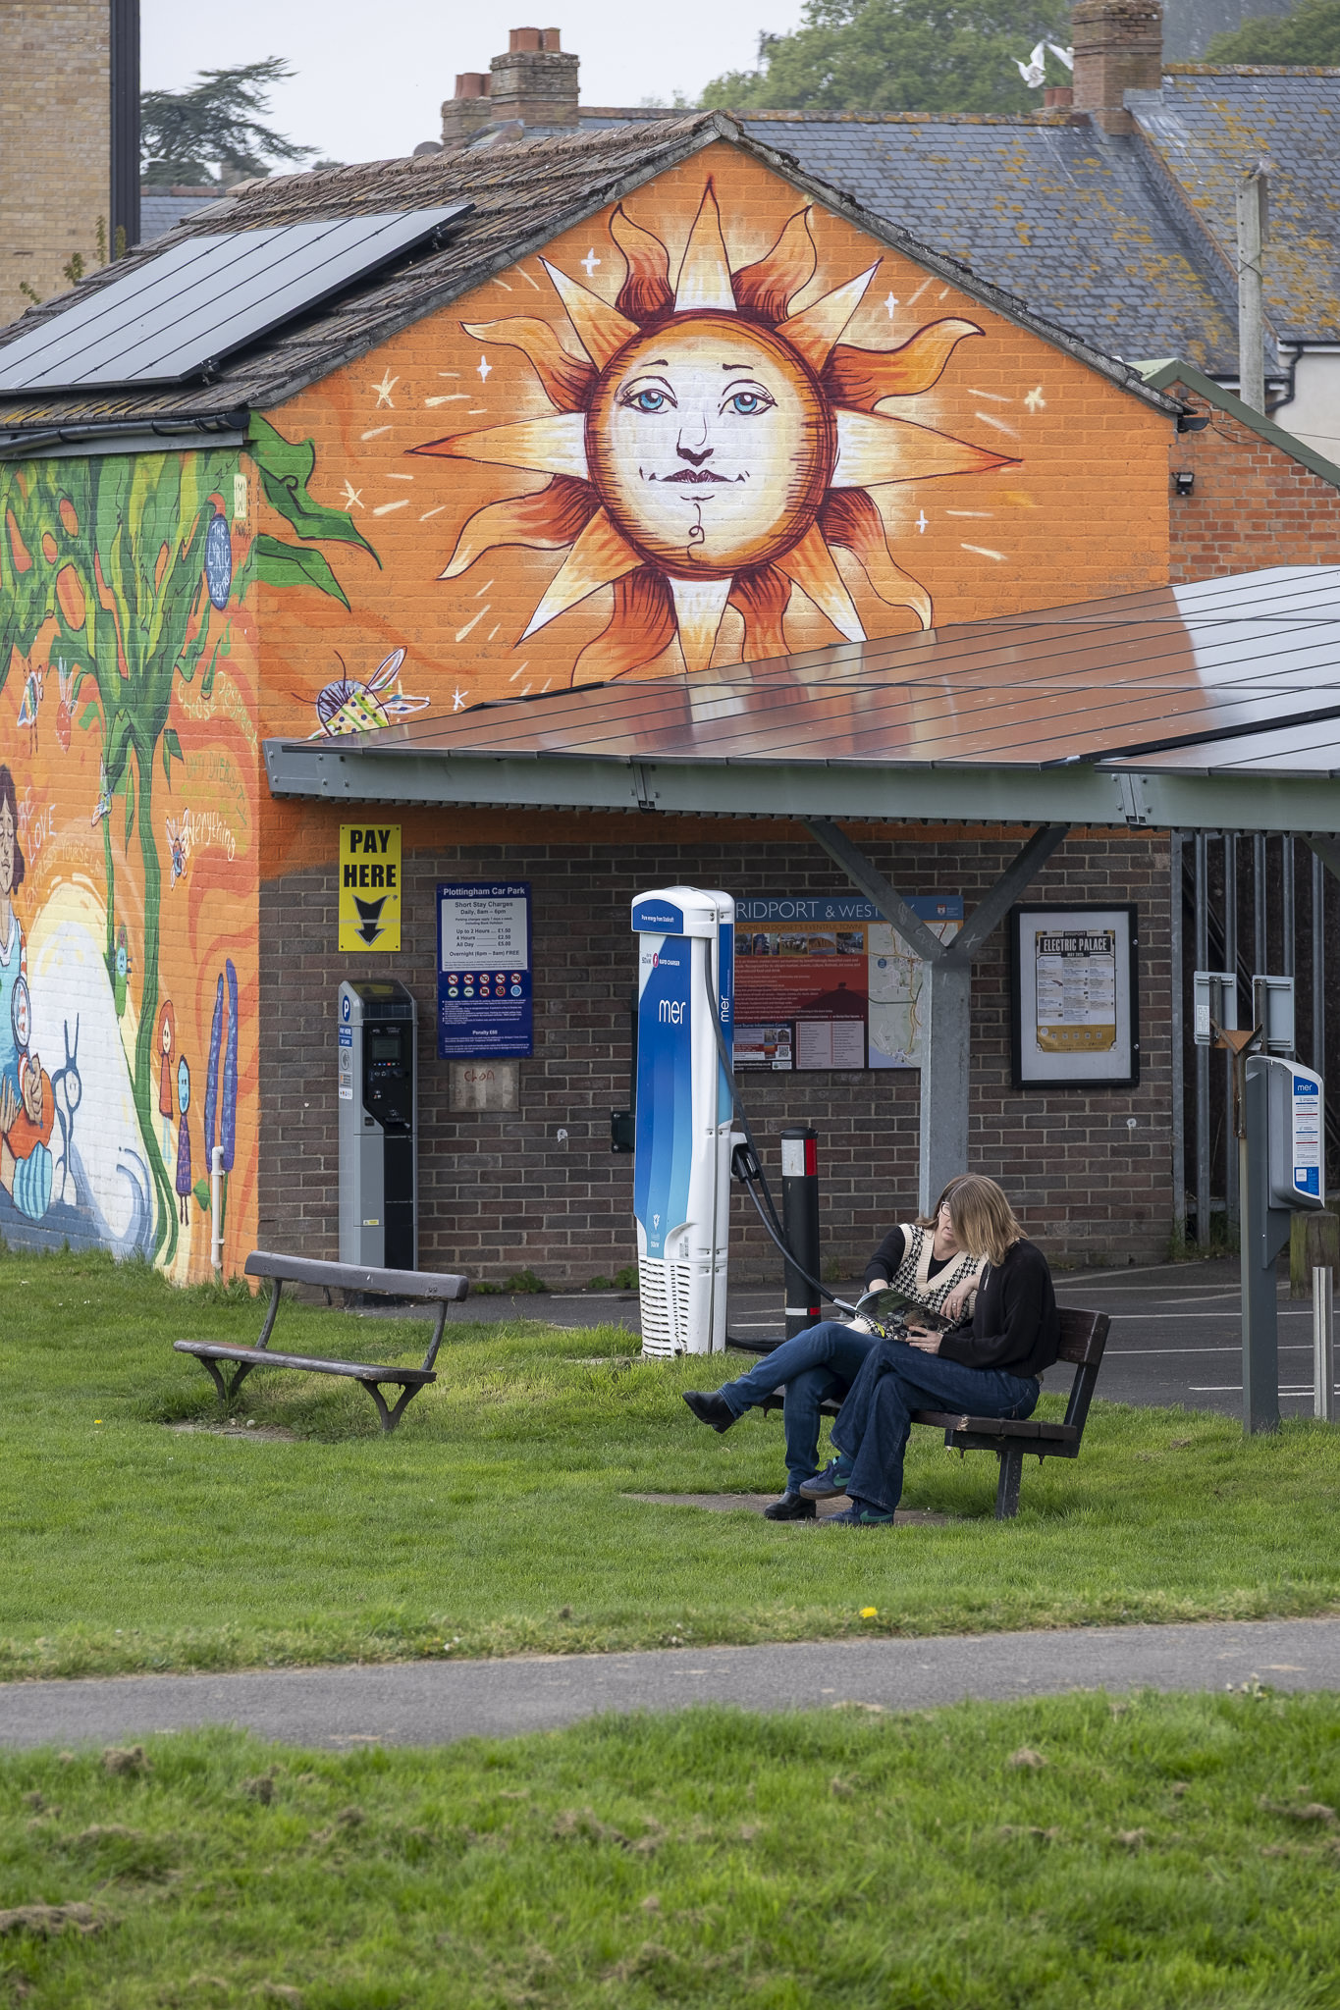
Review Considerations
Greater emphasis has been placed on transition to a net zero future with amendments to the supporting text in the climate change chapters and updating of climate policies.
The Landscape chapter has been updated with supporting text and policy amendments to reflect the requirements of Biodiversity Net Gain legislation.
A new, larger Local Green Space has been proposed as a replacement for the Peter Foote Play Area which has been identified as possibly suitable for a small community led social rent housing development.

Slide 9
Proposed Policy Amendments:
Policy | Revised text (italic)
Policy CC1 Publicising Carbon Footprint. | Applicants should seek to minimise the whole-life carbon footprint of development proposals and are encouraged to submit a statement setting out the anticipated carbon emissions of the proposed development.
Policy AM6 Transport Hub Proposal | b) Make the most efficient use of land and be developed to seek optimum use resulting from a design led approach to determine the capacity of the site with regard to the provision of social rent housing.
Policy EE2 Provision for New & Small Businesses | Support will be given for developments on sites that provide for: b) Co-working hubs and live-work spaces.
Policy H2: Placement of Affordable Housing | Affordable housing and open market housing will be fully integrated and evenly distributed across sites in such a way that once completed any quality and location differences are indiscernible. An exception can be made in cases where the affordable portion of a development is to be completed ahead of the open-market portion.

Slide 10
Proposed Policy Amendments:
Policy | Revised text (italic)
Policy H4: Housing Mix & Balanced Community | To ensure a balanced community, major housing applications will contain a mix of housing types and sizes to meet a range of needs. The preferred mix will be guided by the latest Bridport Area Housing Needs Assessment and its Supplement, and any subsequent changes to trends in household composition identified by the local planning authority. To help shape a balanced future community, developments of smaller, lower-cost homes will be strongly preferred. Developments offering mainly 3-bedroom or greater properties will be opposed.
Policy H5: Sheltered or Retirement Home or Extra Care Home Developments | A new or extended Sheltered, Retirement or Extra Care home development will: 1. Location a) Be located within a defined development boundary and be of an appropriate scale in relation to its setting. b) Be located so as to afford reasonably level and easy access to shopping and social facilities whether on foot or by use of mobility scooter or similar, except for Extra Care homes where this restriction does not apply. 2. Need Be subject to a proven local need for the development in the neighbourhood plan area or its closely surrounding parishes. 3. Priority Be given less priority than Affordable Housing except where the sheltered or retirement homes may be, in themselves, affordable.

Slide 11
Proposed Policy Amendments
Policy | Revised text (italic)
Policy CF1 | Addition to list of: Assembly Rooms British Legion Hall Masonic Hall Hazelmead Common House
Policy L1 Green Corridors, Footpaths, Surrounding Hills & Skylines | 1. Proposals must preserve and enhance the natural beauty of the Dorset National Landscape… 2. Proposals that do not preserve and enhance the Dorset National Landscape will be refused.
Policy L2 Biodiversity | 1. Development proposals that meet the mandatory biodiversity net gain (BNG) requirements*, will need to use the BNG metric tool to demonstrate how they will deliver habitat improvement to benefit biodiversity. Where feasible developers are encouraged to seek biodiversity gains over and above the 10% mandated by government. 3. New developments will be encouraged to consider creating new or enhancing existing habitats, such as incorporating ‘swift bricks’ and bat boxes in developments over 5 metres or providing safe routes for hedgehogs between different areas of habitat or providing green roofs, green walls, street trees or sustainable drainage systems.

Slide 12
Proposed Policy Amendments:
Policy | Revised text (italic)
Policy L3 Local Green Spaces | Area N Peter Foote Play Area replaced with a new, larger area called Riverside Corridor.
Policy D9: Environmental performance (see also Policies CC2, CC3) | g) Designing homes to meet Building Regulations Part M4(2) category 2: Accessible and Adaptable dwellings.

Slide 13

Regulation 14 Consultation
The revised BANP is out for public comment
It is a requirement that revised neighbourhood plans be made available for comment by the public and a wide range of statutory and non statuary organisations.
The revised BANP consultation is open between Oct 18th - December 30th 2025.
An online questionnaire is available for comments - paper copies are available from Bridport TIC/BTC Offices at Mountfield and from Symondsbury Parish Council.
Public meetings to discuss the revised BANP will be held throughout Oct/Dec. ( see BANP Poster)
For enquiries regarding the BANP Review email: enquiries@bridport-tc.gov.uk

